Slide 1

Data Structures
Week 13 BFS, DFS, Dijkstra
Juan Carlos Pineda
ITESM
juancarlos.pineda@itesm.mx

Slide 2
Breadth-first search
Breadth first search (BFS) finds a path between 2 nodes by taking one step down all paths and then immediately backtracking.
Implemented by maintaining a queue of vertices to visit.
Always returns shortest path (i.e. fewest edges) from start to end.
a
b
c
BS from a to i
a -> b
a->d
a->e
a->d->g
a->d->h
a->e->f
a->d->h->i
Path returned: (a,d,h,l)
d
e
f
g
h
i

Slide 3
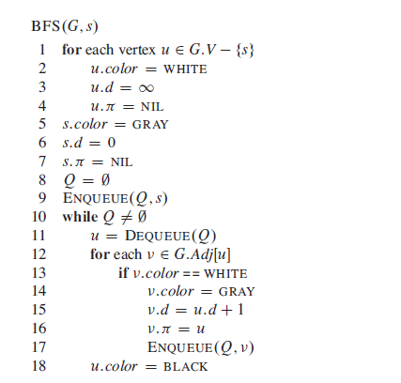
BFS

Slide 4
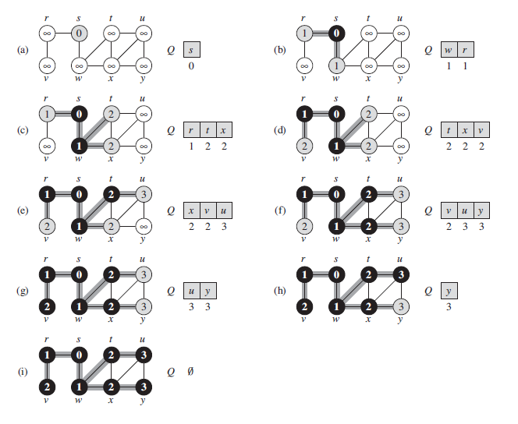
BFS

Slide 5
BFS
a
b
c
d
e
f
g
h
i
Trace bfs(a,f) assuming A-Z edge visit order
{a,e,f} B) {a,d,h,f} C) {a,d,g,h,f} D) {ab.f}
Notes:
A is the right answer

Slide 6
BFS
Optimally:
Always finds the shortest path
In unweighted graphs, finds optimal cost path
In weighted graphs, NOT always optimal cost
retrieval : harder to reconstruct the actual sequence of vertices or edges in the path once you find it
DFS use less memory than BFS, easier to reconstruct the path once found; but DFS does not always find shortest path. BFS does.

Slide 7
Depth-first search (DFS)
Depth-first search (DFS) finds a path between two vertices by exploring each possible path as far as possible before backtracking
Often implemented recursively
Many graph algorithms involve visiting or marking vertices
DFS from a to h
a
b
c
e
f
c
i
d
g
h
Path found: {a,d,g,h}
a
b
c
d
e
f
g
h
i

Slide 8
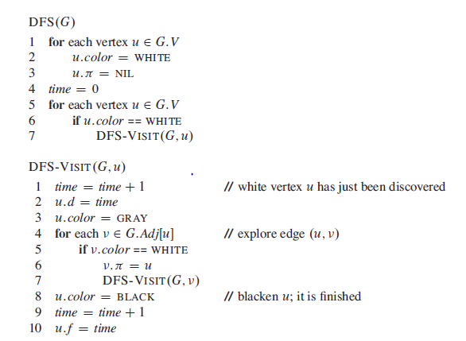
DFS

Slide 9
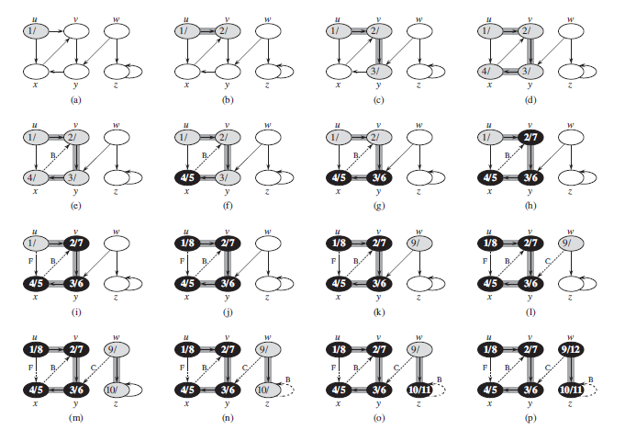
DFS

Slide 10
DFS, BFS runtime
Expected runtime of DFS and BFS in terms of the number of vertices V and the number of edges E:
O(V+E)
Must potentially visit every node and/or examin

Slide 11
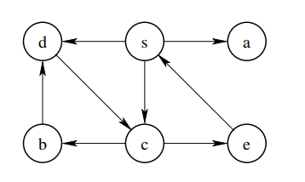
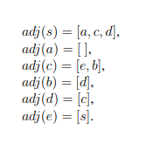
BFS/DFS
BFS
DFS
Notes:
BFS: s a c d e b
DFS: s a c e b d

Slide 12
Priority Queues
Priority queues have operations to add elements with data and a priority
Real life scenarios:
Printing queue
Surgery Scheduling
Operations in a priority queue:
Add an element (print job, patient, etc)
get/remove the most important or priority element

Slide 13
Priority Queues
Priority Queue is an extension of queue with following properties.
Every item has a priority associated with it.
An element with high priority is dequeued before an element with low priority.
If two elements have the same priority, they are served according to their order in the queue.

Slide 14

Edsger Dijkstra
Computer Scientist, prof at UT Austin and winner of Turing Award
Achievements
THE multiprogramming system (OS)
Compiler for a language that can do recursion
Dijkstra’s algorithm
Dining Philosophers Problem

Slide 15
DFS/BFS weights
DFS and BFS do not consider edge weights
The minimum weight path is not necessarily the shortest path
Sometimes weight is more important:
Example: plane flight costs, network transmissions (throttling)
a
4
b
c
4
2
7
1
d
e
2
f
4
1
5
g
h
1

Slide 16
Dijkstra’s Algorithm
Finds the minimum-weight path between two vertices in a weighted directed graph
Basic algorithm concept: Create a table of information about the currently known best way to reach each vertex (cost, previous vertex), and improve it until it reaches a the best solution
Example: In a graph where vertices are cities and weighted edges are roads between cities, Dijkstra’s algorithm can be used to find the shortest route from one city to any other

Slide 17
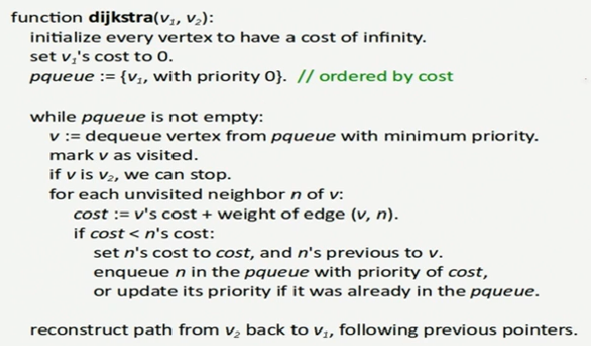
Dijkstra’s algorithm

Slide 18
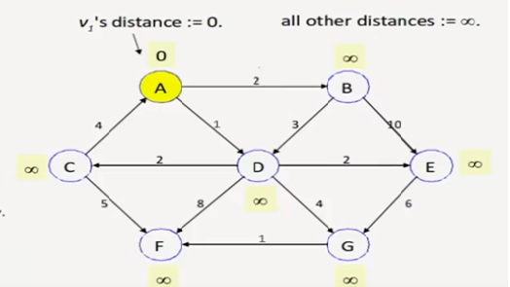
Example

Slide 19
Heaps
Heaps
A heap is a binary tree (in which each node contains a Comparable key value), with two special properties:
The ORDER property:
For every node n, the value in n is greater than or equal to the values in its children (and thus is also greater than or equal to all of the values in its subtrees).
The SHAPE property:
All leaves are either at depth d or d-1 (for some value d).
All of the leaves at depth d-1 are to the right of the leaves at depth d.
(a) There is at most 1 node with just 1 child. (b) That child is the left child of its parent, and (c) it is the rightmost leaf at depth d.

Slide 20
Priority Queues with Heaps
Now let's consider how to implement priority queues using a heap. The standard approach is to use an array (or an ArrayList), starting at position 1 (instead of 0), where each item in the array corresponds to one node in the heap:
The root of the heap is always in array[1].
Its left child is in array[2].
Its right child is in array[3].
In general, if a node is in array[k], then its left child is in array[k*2], and its right child is in array[k*2 + 1].
If a node is in array[k], then its parent is in array[k/2] (using integer division, so that if k is odd, then the result is truncated; e.g., 3/2 = 1).

Slide 21
End of presentation

